Slide 1
Robot Catchers
An overview of the current state of the art
Tom Queen
Daniel Turner
Demetrius Zaibo

Slide 2
Catching Robots
What are they?
Machines which automatically grasp or intercept a target moving object
How could they be useful
Impromptu conveyor systems over uneven terrain
Robotic assistants on space walks
Sports training
Toys

Slide 3
Design Challenges: Hardware
Body Design
Effective work area
Strength, speed and safety
Power consumption
Gripper Design
Catchable objects
Post-catch manipulation
Control complexity

Slide 4
Design Challenges: Visual Feedback
Camera Setup
Influences required processing power
Feedback accuracy, precision and frequency
System complexity
Object Tracking
Object recognition and categorisation
Feedback reliability
Algorithm processing efficiency

Slide 5
Design Challenges: Control
Gripper-Object Coordination
Body kinematics and control
System reliability
Object Grasping
Training
Object models
No generic solution
Notes:
As is the case with such complex problems, many different designs have been made in order to solve them. Each with their own benefits and costs.
To get a better feel for the state of the art, we’ll briefly analyse some of the more common solutions for each of the challenges.

Slide 6
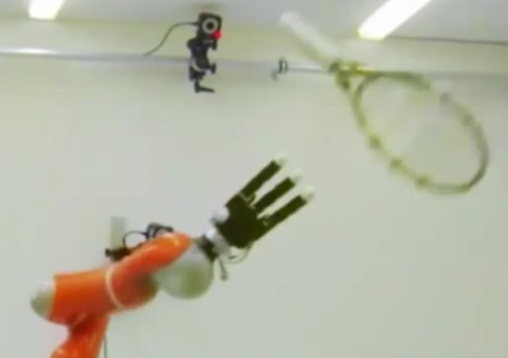
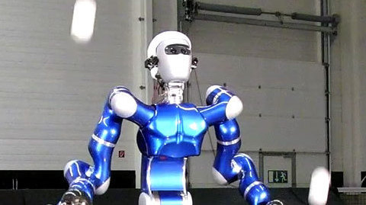
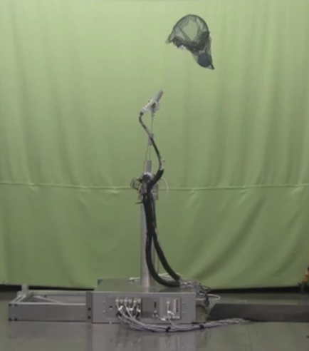
Design Solutions: Body Designs (Arms)
Industrial Arms:
Strong, fast, and standardised
Expensive, fixed workspace, and human unfriendly
Humanoid:
Safe(r) and can mimic humans
Expensive, complex control
Pendulums
Simple design, cheap
Small, fixed workspace

Slide 7
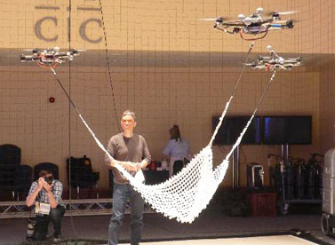
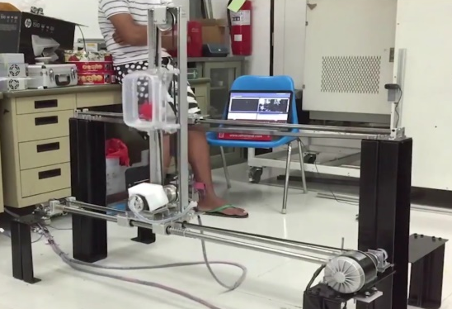
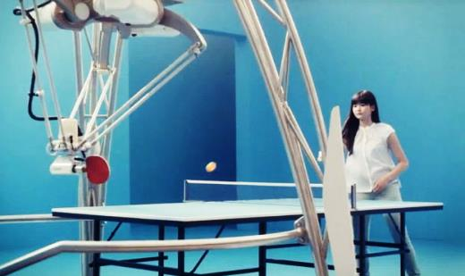
Design Solutions: Body Designs (Supports)
2-Axis Frames
Simple design and control
Limited workspace, bulky
Delta Frames
Simple control, large workspace
Bulkier, many moving parts
Flying Nets
Massive workspace with a very simple design
VERY complicated control

Slide 8
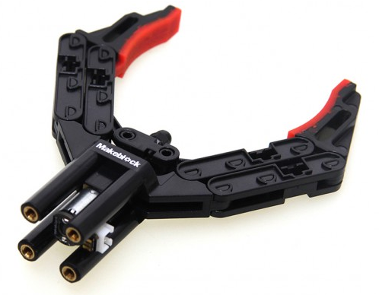
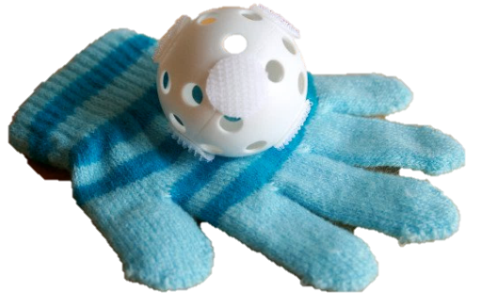
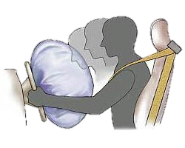
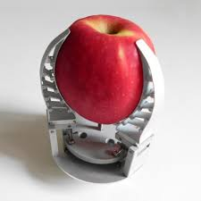
Design Solutions: Gripper Designs (Passive Vs Active)
Active grippers have an element of control
Allows for manipulation of objects post-catch
Passive grippers trade control for simplicity
Usually lighter weight, no cables required!

Slide 9
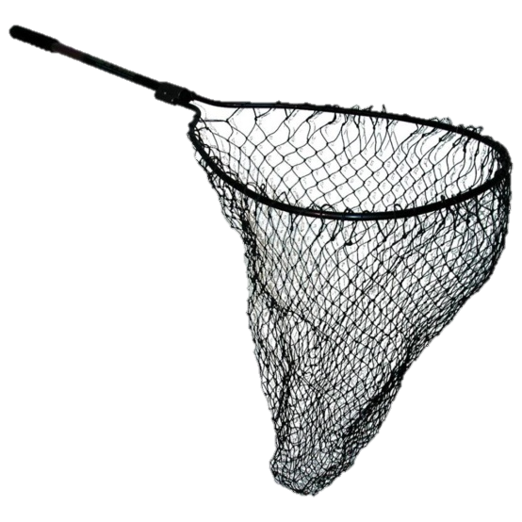
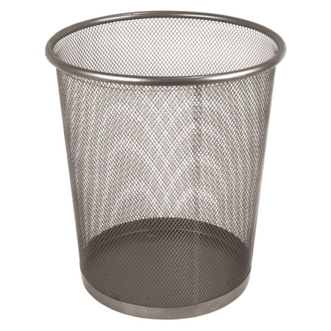
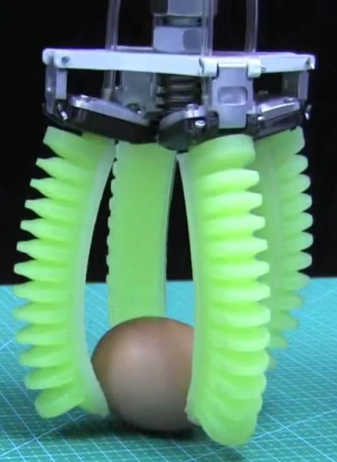
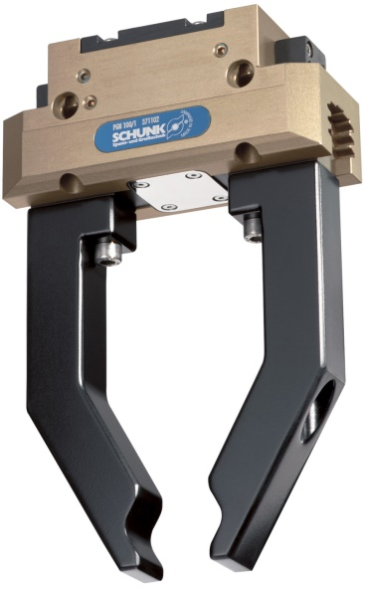
Design Solutions: Gripper Designs (Soft Vs Hard)
Hard grippers are prevalent in industry
Standardised, simple and well tested
Soft grippers are prevalent in nature
Deformable, safe and versatile

Slide 10
Design Solutions: Camera Setups
Eye in hand
Simple feedback systems
Increased gripper design complexity
Head camera(s)
Improved object tracking
Increased control complexity
Room camera(s)
Excellent object tracking
Complex robot setup, more processing required

Slide 11
Design Solutions: Object Tracking
Colour
Simple algorithms
Limited to known items, many false positives
Structure
More complex algorithms
Limited to known items
Depth
Not limited to certain items
Larger hardware and computational costs

Slide 12
Design Solutions: Gripper-Object Coordination
Kinematic Models
Standardised solutions, e.g. ROS
Predictive Feedback
Can intercept via predicting object trajectories
Visual Servoing
For eye-in-hand and grid-based setups direct (reactive) feedback loops are possible

Slide 13
Design Solutions: Object Grasping
Open Problem!
Active area of research
Usually train with known objects and constrained throwing (e.g. object won’t spin)
Often just ignored with passive robotics

Slide 14
Summary
Catching robotics is an active area of research
Many solutions are being tested
Most challenges cross-over into other areas of research, e.g. visual processing
Grasping and manipulating objects is hard

Slide 15
Questions?

